Slide 1
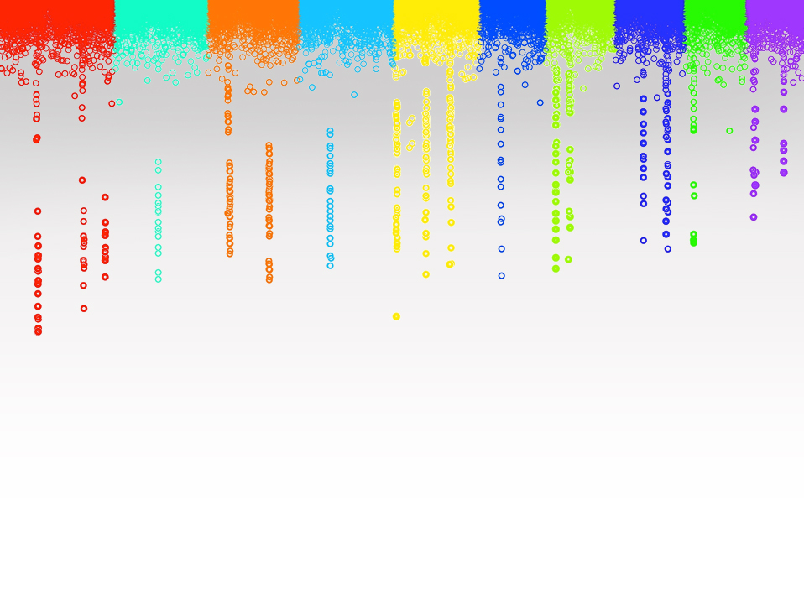

Statistical Genomics
Lecture 15: MLM
Zhiwu Zhang
Washington State University

Slide 2
Outline
From GLM to MLM
Concept and working models
Incorporating kinship for GWAS
BLUE and BLUP
MLM in GAPIT
GLM in GAPIT

Slide 3
GWAS by correlation
#Import data
myGD=read.table(file="http://zzlab.net/GAPIT/data/mdp_numeric.txt",head=T)
myGM=read.table(file="http://zzlab.net/GAPIT/data/mdp_SNP_information.txt",head=T)
#Import function
setwd("~/Dropbox/Current/ZZLab/WSUCourse/CROPS545/Demo")
source("G2P.R")
source("GWASbyCor.R")
#Simulation
X=myGD[,-1]
index1to5=myGM[,2]<6
X1to5 = X[,index1to5]
set.seed(99164)
mySim=G2P(X= X1to5,h2=.75,alpha=1,NQTN=10,distribution="norm")
#GWAS
p= GWASbyCor(X=X,y=mySim$y)

Slide 4
color.vector <- rep(c("deepskyblue","orange","forestgreen","indianred3"),10)
m=nrow(myGM)
plot(t(-log10(p))~seq(1:m),col=color.vector[myGM[,2]])
abline(v=mySim$QTN.position, lty = 2, lwd=2, col = "black")

Slide 5
QQ plot
p.obs=p
m2=length(p.obs)
p.uni=runif(m2,0,1)
order.obs=order(p.obs)
order.uni=order(p.uni)
plot(-log10(p.uni[order.uni]),
-log10(p.obs[order.obs]), )
abline(a = 0, b = 1, col = "red")

Slide 6
Association with phenotypes
r=-0.32
PCA=prcomp(X)
plot(mySim$y,PCA$x[,2])
cor(mySim$y,PCA$x[,2])

Slide 7
Add 2nd PC as covariate
y=mySim$y
G=myGD[,-1]
n=nrow(G)
m=ncol(G)
P=matrix(NA,1,m)
for (i in 1:m){
x=G[,i]
if(max(x)==min(x)){
p=1}else{
X=cbind(1, PCA$x[,2],x)
LHS=t(X)%*%X
C=solve(LHS)
RHS=t(X)%*%y
b=C%*%RHS
yb=X%*%b
e=y-yb
n=length(y)
ve=sum(e^2)/(n-1)
vt=C*ve
t=b/sqrt(diag(vt))
p=2*(1-pt(abs(t),n-2))
} #end of testing variation
P[i]=p[length(p)]
} #end of looping for markers

Slide 8
QQ plot
p.obs=P
m2=length(p.obs)
p.uni=runif(m2,0,1)
order.obs=order(p.obs)
order.uni=order(p.uni)
plot(-log10(p.uni[order.uni]),
-log10(p.obs[order.obs]), )
abline(a = 0, b = 1, col = "red")

Slide 9
Using more PCs
G=myGD[,-1]
n=nrow(G)
m=ncol(G)
P=matrix(NA,1,m)
for (i in 1:m){
x=G[,i]
if(max(x)==min(x)){
p=1}else{
X=cbind(1, PCA$x[,1:3],x)
LHS=t(X)%*%X
C=solve(LHS)
RHS=t(X)%*%y
b=C%*%RHS
yb=X%*%b
e=y-yb
n=length(y)
ve=sum(e^2)/(n-1)
vt=C*ve
t=b/sqrt(diag(vt))
p=2*(1-pt(abs(t),n-2))
} #end of testing variation
P[i]=p[length(p)]
} #end of looping for markers

Slide 10
QQ plot
p.obs=P
m2=length(p.obs)
p.uni=runif(m2,0,1)
order.obs=order(p.obs)
order.uni=order(p.uni)
plot(-log10(p.uni[order.uni]),
-log10(p.obs[order.obs]), )
abline(a = 0, b = 1, col = "red")

Slide 11
color.vector <- rep(c("deepskyblue","orange","forestgreen","indianred3"),10)
m=nrow(myGM)
plot(t(-log10(P))~seq(1:m),col=color.vector[myGM[,2]])
abline(v=mySim$QTN.position, lty = 2, lwd=2, col = "black")

Slide 12
Hidden, observed, induction, and modeling
Genes
SNPs
PCs
y=SNP+e
y=SNP+PC+e
y=SNP+PC+K+e
y=SNP+PC+BLUP+e
BLUP=SNP+e
BLUP=SNP+PC+e
Residual=SNP+e
Residual=SNP+PC+e
Y=SNP1 + SNP2+ … + e
K
BV
BLUP
y
Residual
Hidden
Observed
Induction
Modeling

Slide 13
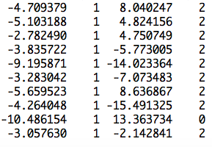
More covariates
observation
mean
PC2
SNP
Ind1 | Ind2 | … | Ind9 | Ind10
u1 | u2 | … | u9 | u10
1 | 0 | … | 0 | 0
0 | 1 | … | 0 | 0
0 | 0 | … | 1 | 0
0 | 0 | … | 0 | 1
u=
]
[
]
[
b=
b0
b1
b2
y
1
x1
x2
=X
Z
[
]
y = Xb + Zu +e

Slide 14
Recall for linear model
y=b₀ + x₁b₁ + x₂b₂ + … + x_{p}b_{p} + e
y: observation, dependent variable
x: Explainary/independent variables
e: Residuals/errors
Δ =e₁² + e₂² + … + e_{n}²
=e'e
=(y-Xb)'(y-Xb)

Slide 15
Optimization to minimize residual
Δ =e'e
=e²=(y-Xb)²
∂Δ/∂b
=2X'(y-Xb)
=2X'y-2X'Xb=0
X'Xb=X'y
b=[X'X]⁻¹[X'Y]

Slide 16
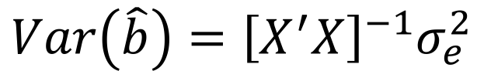
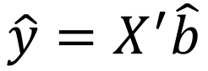
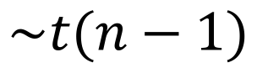
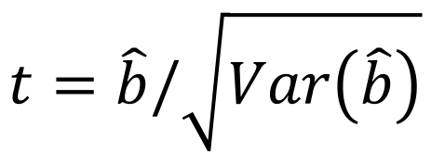
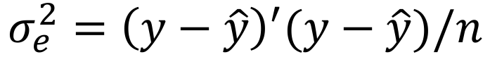
Statistical test
$$\hat{y}=X^{′}\hat{b}$$
$$σ_{e}^{2}={\left(y−\hat{y}\right)}^{′}(y−\hat{y})/n$$
$$Var\left(\hat{b}\right)={\left[X^{′}X\right]}^{−1}σ_{e}^{2}$$
$$t=\hat{b}/\sqrt{Var\left(\hat{b}\right)}$$
$$\sim t(n−1)$$

Slide 17
GLM (Conceptual)
Phenotype on individuals
Population
structure
y = SNP + Q (or PCs) +
e
(fixed effect)
(fixed effect)
General Linear Model (GLM)

Slide 18
Minimize residual does not work for adding individuals' effects
More parameters than observations
Residuals are always zero due to over model fitting
Needs new rules
X

Slide 19
New rules
Free individuals effects
Only regulate the features for the population where they from: means (0) and variances
Optimize variances according to kinship and observation to maximize the likelihood

Slide 20
MLM for GWAS
Phenotype
Population
structure
Unequal
relatedness
Y = SNP + Q (or PCs) + Kinship + e
(fixed effect)
(fixed effect)
(random effect)
General Linear Model (GLM)
Mixed Linear Model (MLM)
(Yu et al. 2005, Nature Genetics)

Slide 21
Fixed vs. Random Effects
Fixed effect
Limited levels
Interest on levels
Radom effect
Many levels
Interest on population behind the levels (mean, variance)

Slide 22
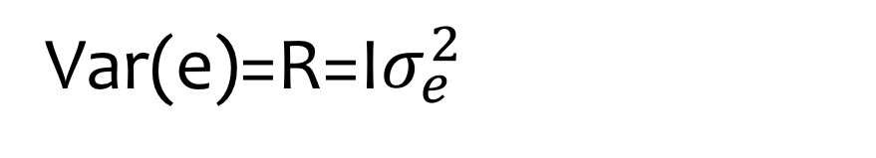
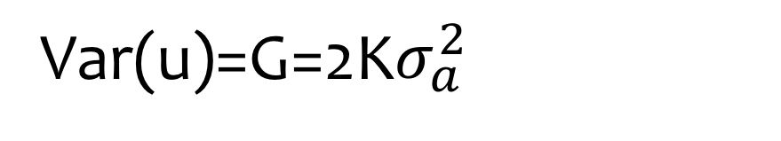
Mixed Linear Model (MLM)
y = Xb + Zu + e
Var(y)=V=Var(u)+Var(e)
Var(u)=G=2K$σ_{a}^{2}$
Var(e)=R=I$σ_{e}^{2}$
u prediction: Best Linear Unbiased Prediction, BLUP)
b prediction: Best Linear Unbiased Estimate, BLUE)

Slide 23
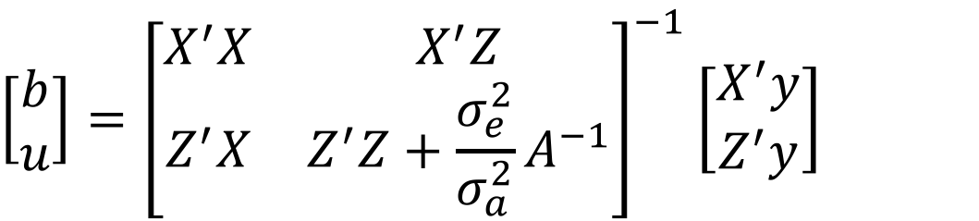
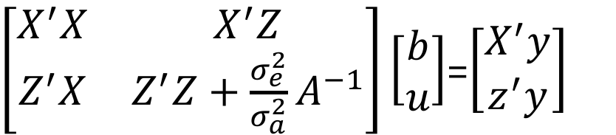
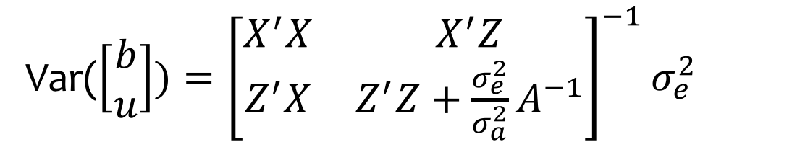
Mixed Model Equation
y = Xb + Zu + e
$\left[\begin{matrix}X^{′}X & X^{′}Z \\ Z^{′}X & Z^{′}Z+{\frac{σ_{e}^{2}}{σ_{a}^{2}}A}^{−1}\end{matrix}\right]\left[\begin{matrix}b \\ u\end{matrix}\right]$=$\left[\begin{matrix}X^{′}y \\ z^{′}y\end{matrix}\right]$
$$\left[\begin{matrix}b \\ u\end{matrix}\right]={\left[\begin{matrix}X^{′}X & X^{′}Z \\ Z^{′}X & Z^{′}Z+{\frac{σ_{e}^{2}}{σ_{a}^{2}}A}^{−1}\end{matrix}\right]}^{−1}\left[\begin{matrix}X^{′}y \\ Z^{′}y\end{matrix}\right]$$
Var($\left[\begin{matrix}b \\ u\end{matrix}\right])={\left[\begin{matrix}X^{′}X & X^{′}Z \\ Z^{′}X & Z^{′}Z+{\frac{σ_{e}^{2}}{σ_{a}^{2}}A}^{−1}\end{matrix}\right]}^{−1}σ_{e}^{2}$

Slide 24
GWAS with MLM in GAPIT
myGAPIT=GAPIT(
Y=myY,
GD=myGD,
GM=myGM,
QTN.position=mySim$QTN.position,
PCA.total=3,
File.output=FALSE,
group.from=1000000,
group.to=1000000,
group.by=10)
Set group.from and group.to as a big number (e.g. 1M) for MLM in GAPIT

Slide 25
GWAS by MLM
library('MASS') # required for ginv
library(multtest)
library(gplots)
library(compiler) #required for cmpfun
library("scatterplot3d")
source("http://www.zzlab.net/GAPIT/emma.txt")
source("http://www.zzlab.net/GAPIT/gapit_functions.txt")
myGD=read.table(file="http://zzlab.net/GAPIT/data/mdp_numeric.txt",head=T)
myGM=read.table(file="http://zzlab.net/GAPIT/data/mdp_SNP_information.txt",head=T)
setwd("~/Dropbox/Current/ZZLab/WSUCourse/CROPS545/Demo")
source("G2P.R")
set.seed(99164)
mySim=G2P(X= X1to5,h2=.75,alpha=1,NQTN=10,distribution="norm")
setwd("~/Desktop/temp")
myY=cbind(as.data.frame(myGD[,1]), mySim$y)
myGAPIT=GAPIT(
Y=myY,
GD=myGD,
GM=myGM,
QTN.position=mySim$QTN.position,
PCA.total=3,
group.from=1000000,
group.to=1000000,
group.by=10,
memo="MLM",
file.output=TRUE,)

Slide 26
GWAS by GLM
library('MASS') # required for ginv
library(multtest)
library(gplots)
library(compiler) #required for cmpfun
library("scatterplot3d")
source("http://www.zzlab.net/GAPIT/emma.txt")
source("http://www.zzlab.net/GAPIT/gapit_functions.txt")
myGD=read.table(file="http://zzlab.net/GAPIT/data/mdp_numeric.txt",head=T)
myGM=read.table(file="http://zzlab.net/GAPIT/data/mdp_SNP_information.txt",head=T)
setwd("~/Dropbox/Current/ZZLab/WSUCourse/CROPS545/Demo")
source("G2P.R")
set.seed(99164)
mySim=G2P(X= X1to5,h2=.75,alpha=1,NQTN=10,distribution="norm")
setwd("~/Desktop/temp")
myY=cbind(as.data.frame(myGD[,1]), mySim$y)
myGAPIT=GAPIT(
Y=myY,
GD=myGD,
GM=myGM,
QTN.position=mySim$QTN.position,
PCA.total=3,
group.from=1,
group.to=1,
group.by=10,
memo="GLM",
file.output=TRUE,)

Slide 27
Highlight
From GLM to MLM
Concept and working models
Incorporating kinship for GWAS
BLUE and BLUP
MLM in GAPIT
GLM in GAPIT

